Slide 2
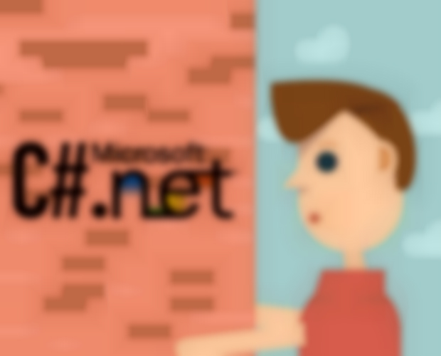

My App for Stock Keeping
Prepared by:
Nabin Dangol
Bibesh Manandhar

Slide 3
Contents
Introduction to C# programming
Introduction to our project
Methodologies used
Uses and benefits of the application
Demo of the application
Limitations

Slide 4
Introduction to C# Programming
C# is a multi-paradigm (i.e. function, Procedural, Symbolic etc.) programming language.
It is has properties of Data Abstraction, Polymorphism and encapsulation as it is a pure Object Oriented Programming Language.
It was developed by Microsoft within its .NET initiative.
It is intended to combine the computing power of C++ with the programming ease of Visual Basic.

Slide 5
Introduction to Our Project
The Title of our project is “My App for Stock Keeping”
One of the very simple applications that is designed and developed using C# platform.
This application is developed for keeping the record of the stock
These records can be very useful for future purposes.
Designed for those small companies having lesser volume of transaction of goods.
Similarly, for those companies who have very less number of debtors as well as creditors.

Slide 6
Methodologies Used
For the development of application, different methods can be applied. For my application, I used following methods:
Analysis of the need of application.
Designing of Flowchart.
Coding and connecting Database.
Implementing.
Solving errors.

Slide 7
Uses and benefits of the application
This application is used to save the amount of received by sales and expensed by purchase by a company.
Similarly, the user of this application is benefited by many things.
Some of the basic things that the user can be benefitted by this application are mentioned below:
More Secure as our application has login function which will hide and make secure all the transaction that occur in the company.
Fast to check their total capital with a single click.
Users can check the total amount of debtors and creditors.
Users can check their drawings amount as well.

Slide 8
Demo of the Application

Slide 9
Limitations
There can be as many as same usernames and password for the application which may bring a conflict.
The account of debtors and creditors are not separate and the whole account is calculated in one account i.e. Debtors and creditors.
The Balance goes to negative also.
Email confirmation is not available.
Login is not as secure as other highly secured banking application of different institution.

Slide 10
Reference
http://searchwindevelopment.techtarget.com/definition/C
https://en.wikipedia.org/wiki/C_Sharp_(programming_language)
https://en.wikipedia.org/wiki/Systems_development_life_cycle
https://github.com/viperneo/winforms-modernui
https://metroui.org.ua/

Slide 11

Thank you !!

Slide 12
THE END

